Slide 1
OA-NV Youth Committee
Strategic Plan

Slide 2
Type of Committee and Area of the Program
This will be a standing committee that meets monthly to plan financial literacy engagement with Nevada’s children, youth, and families.

Slide 3
Mission
To empower Nevada’s young people to become financially literate and fiscally independent.
Provide financial resources and education
Partner with youth serving organizations

Slide 4
Vision
To build a strong community of young Nevadans who are financially empowered and prepared to take advantage of fiscal opportunities.
Young Nevadans are people who are 2-24 years of age,

Slide 5
Committee Organization
Youth Committee meets on the 3rd Tuesday of the month 12:30pm-1:30pm
Chairperson
Co-Chair
Secretary
Members
The Chair shall officiate and conduct meetings including setting agendas and meeting dates. Provide leadership and facilitate discussion amongst committee members and ensure the committee complies with its responsibilities. May be filled by either an OA-NV Board Member or Member. Must commit to at least one-year service term.
The Co-chair will support the Chair in their duties and fill in as Chair in their absence May be filled by either an OA-NV Board Member or member. Must commit to at least one-year service term.
The Secretary will be responsible for ensuring meetings are effectively organized and documented and maintain accurate records and administration (meeting minutes, budget reports, agendas, committee outline, etc.). May be filled by either an OA-NV Board Member or Committee Member. Must commit to at least one-year service term. Minutes of meetings may be scribed by OA staff and provided to Secretary for review.
The committee will consist of active and advisory members. Active members are voting members that attend monthly meetings. Advisory members are non-voting members that mat provide non-binding strategic advice, receive email updates and may or may not attend monthly meetings.

Slide 6
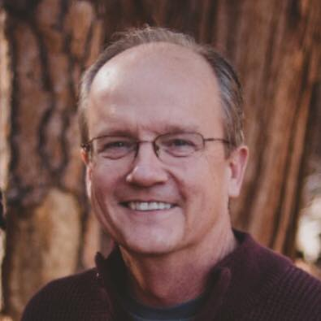
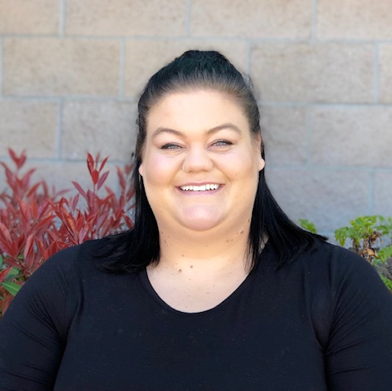
Our Committee
Will consist of interested parties committed to serving on this ‘working committee’ and serving the mission of the OA-NV Youth Committee. Advisory members do not have voting rights but will be important to discussion and insights. Open to the general public and there will be no minimum timeframe for service. Members can be invited to join by anyone.
Ta-Tiana Anderson-Hall
Sydney Oren
Tracy Sherwood
Lisa-Marie Lightfoot
Chairperson
Boys & Girls Club of Truckee Meadows
Co-Chair
Bridges to a Thriving Nevada
Secretary
Washoe County School District
Active
Washoe County School District
John Dickson
Lynne Keller
Mark Pingle
Cori Fisher
Active
Northwestern Mutual
Active
Opportunity Alliance Nevada
Active
University of Nevada, Reno
Active
Boys & Girls Club of Truckee Meadows
Advisory Members: Liliana Wilbert, Lynda Hascheff, Nancy Hamilton

Slide 7
Goals
By building relationships with youth serving organizations, we will help young Nevadans ensure their financial well being. Our partnerships consist of providing educational resources, marketing, fundraising, etc.
Short Term
Long Term
Needs
Continue to identify organizations to work with.
Utilize resources available from other organization,
Create a consistent message for marketables and partner organizations
25% of all Kickstart accounts claimed by Nevada parents
Provide incentives to school staff for taking responsibilities to get Kick-Start accounts claimed
Create a sustainable childcare program for Getting Ahead
Fundraise and develop revenue for incentives, printing and staff
Create subcommittees: marketing, resource development, fundraising etc.
Create measurable goals
Collect and analyze data
Create and maintain communication via social media, website, etc.

Slide 8
Collaboration
Along with the community and available resources we are building sustainable communities across Nevada To stabilize and improve the lives of individuals and families
Getting Ahead
Community Partners
Create and sustain a reliable childcare program for participants
Grants, fundraising, etc.
Incorporate financial literacy into childcare program
Help families create and reach goals for kids
Push Kickstart with Getting Ahead Parents
Have a stronger presence and build relationships with youth-serving organizations
Vet and share financial literacy curriculum with youth serving organizations
Attend and promote financial literacy and Kickstart at youth-community events
Create a consistent message in marketables with partner organizations.

Slide 9
Thank you!
Ta-Tiana Anderson-Hall
Phone:
775-247-2711
Email:
tandersonhall@bgctm.org

